Slide 1
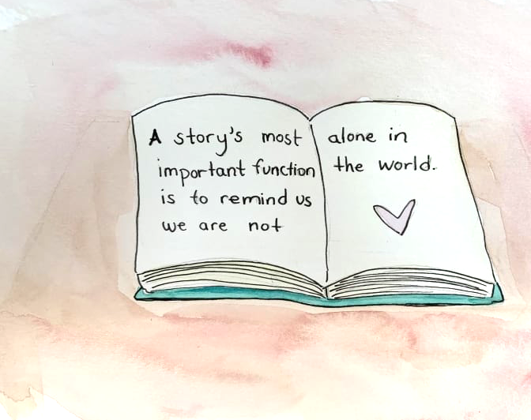
Unit 9 step 5 Writing S.B p74

Slide 2
*Reported the following requests:-
‘’Eat your breakfast’’.
My father asked me ………………………………………………………………………..….
2-‘’Do your homework’’.
My teacher……………………………………………………………….……………………………
‘’Don’t eat sweets’’
My mother …………………………………………………………………………………………….

Slide 3
*Reported the following requests:-
‘’Eat your breakfast’’.
My father asked me to eat my breakfast.
2-‘’Do your homework’’.
My teacher asked me to do my homework.
‘’Don’t eat sweets’’
My mother not to eat sweets.

Slide 5
What comes to your mind?

Slide 6
What do you think about her?

Slide 7
How do you feel?

Slide 8
What did you learn from the story?

Slide 9
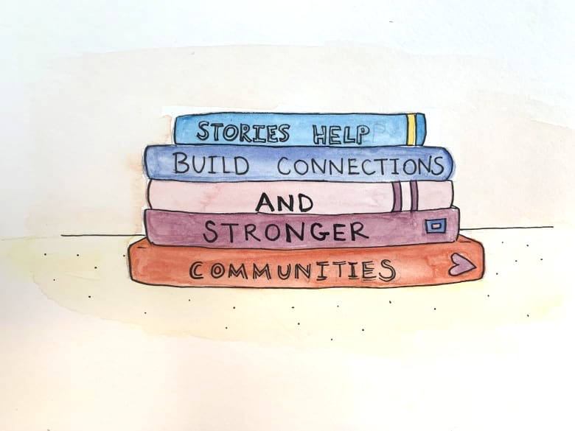
Sources of stories:
Read books

Slide 10
Sources of stories:
Social media

Slide 11
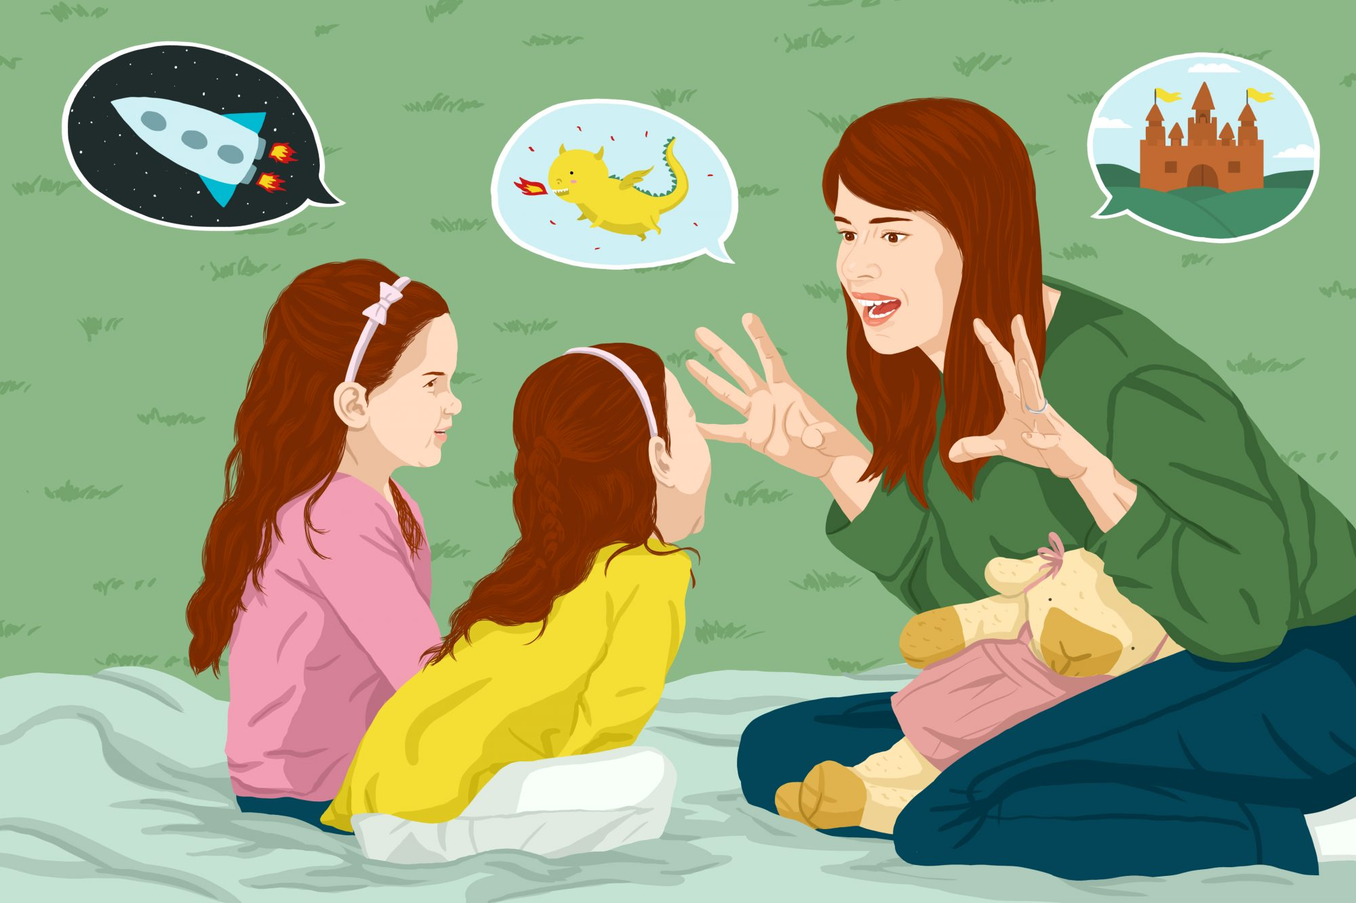
Sources of stories:
Family and friends

Slide 12
The importance of stories

Slide 13
They teach us good morals

Slide 14
They give us information

Slide 15
They convey messages

Slide 16
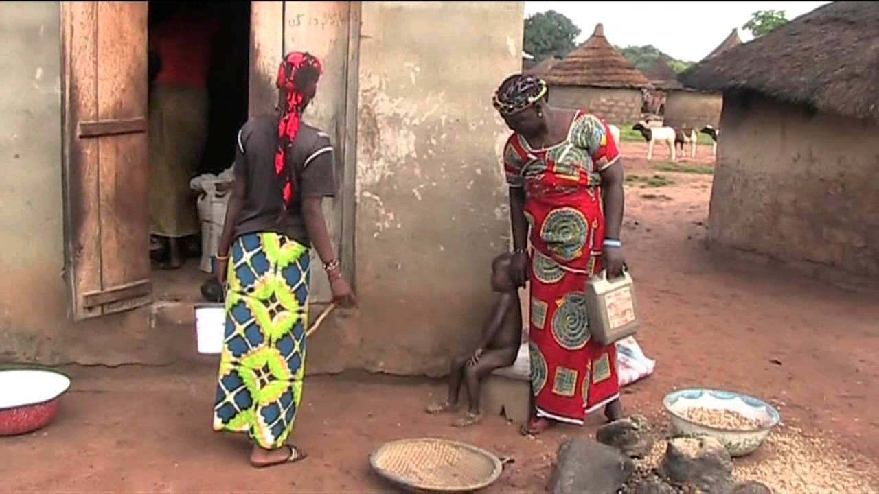
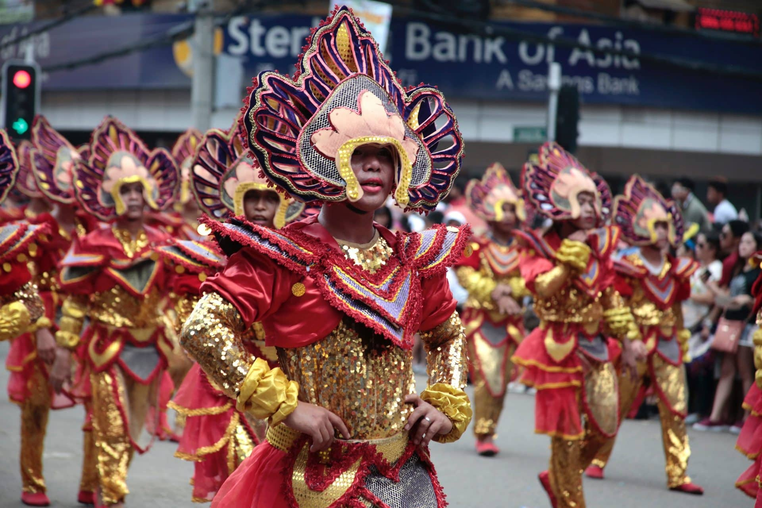
They help us understand the world

Slide 17
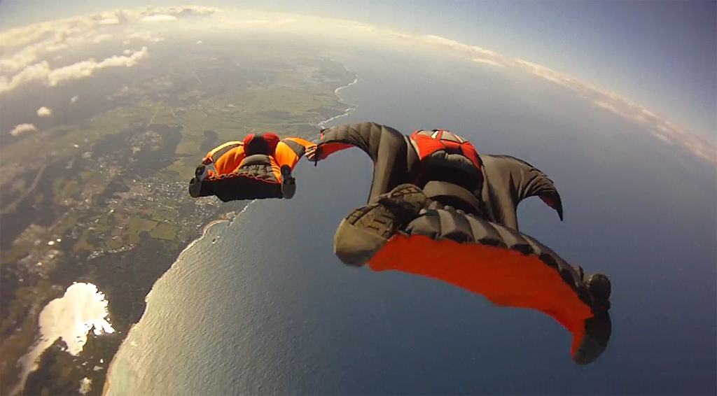
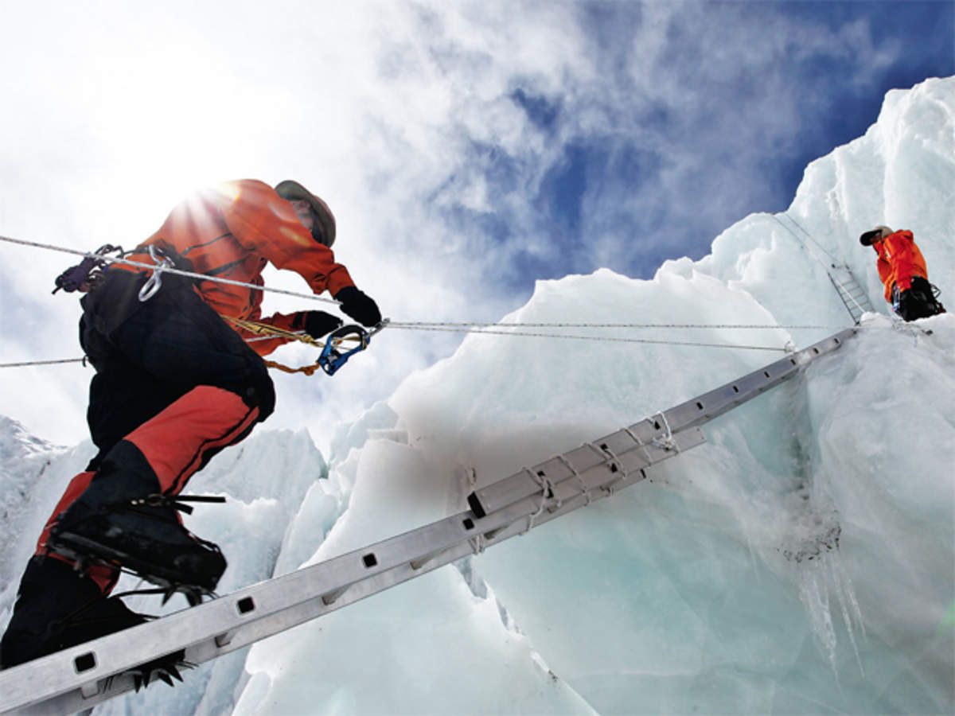
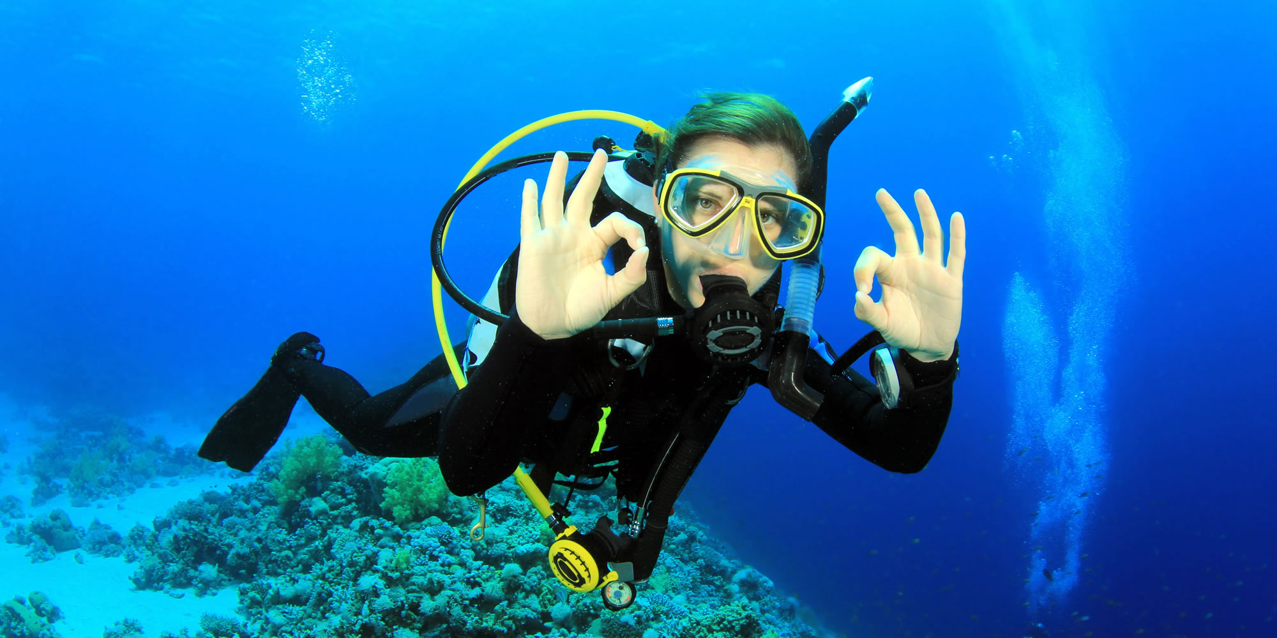
They convey experience

Slide 18
Stories are powerful
Today I will talk about stories. Stories are important in our life. We can hear stories everywhere. We hear stories from family and friends. We read stories from books. We get stories from TV and social media.
We like stories because they are important. They teach us good morals. They can give us information. They can convey messages. They can help us understand the world. They can convey experiences.

Slide 19
Stories are powerful
Today I will talk about stories. Stories are important in our life. We can hear stories everywhere. We hear stories from family and friends. We read stories from books. We get stories from TV and social media.

Slide 20
We like stories because they are important. They teach us good morals. They can give us information. They can convey messages. They can help us understand the world. They can convey experiences.

Slide 21
Unit 9 step 6 Revision W.B p74

Slide 22
Digital Etiquette
engage (v)

Slide 23
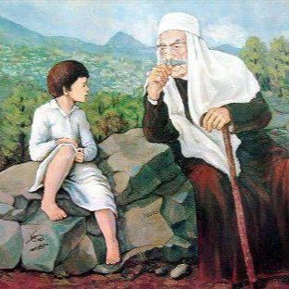
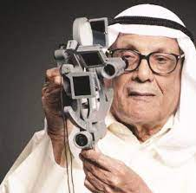
Virtual Meeting ETIQUETTE
Page 1
wisdom (n)
Go to NEXT SLIDE

Slide 24
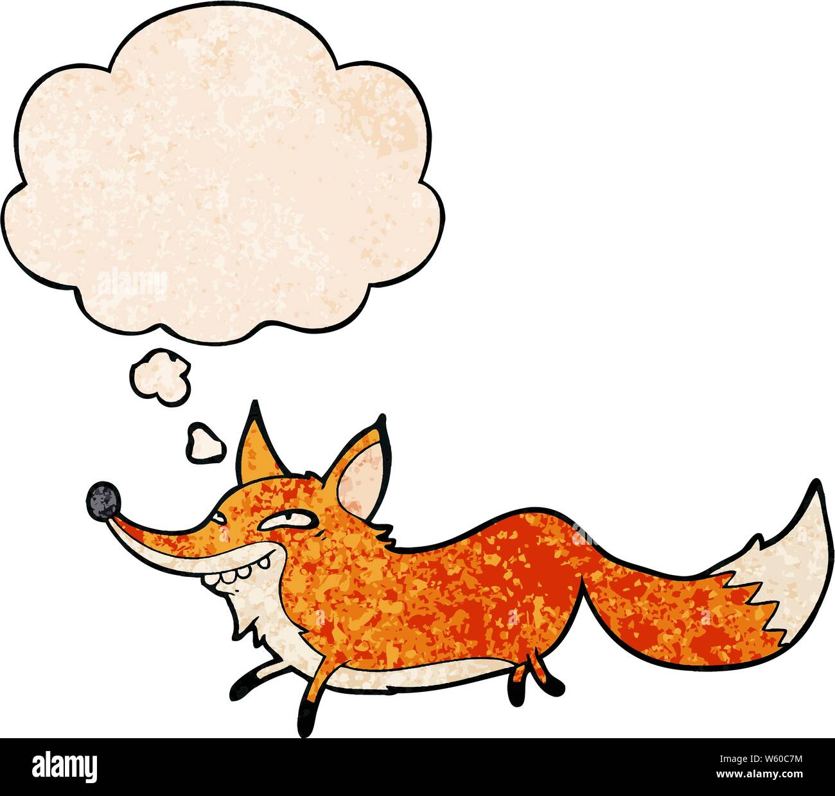
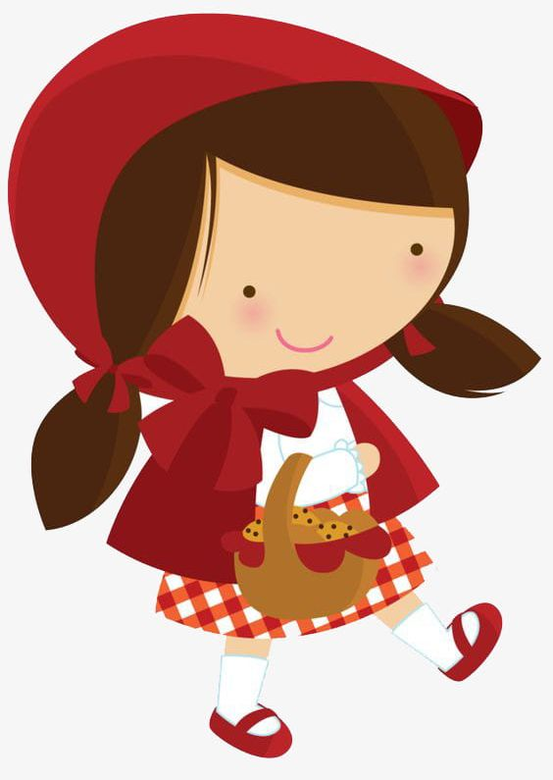
outwit (V)

Slide 25
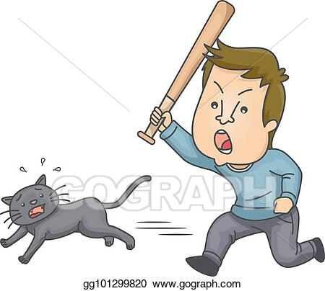
cruel (Adj.)

Slide 26
W.B p 27

Slide 27
W.B p 27
C
E
A
D

Slide 28
W.B p 27

Slide 29
W.B p 27
look after their children.
are you lookingfor
look up in a book
Look out

Slide 30
W.B p28

Slide 31
W.B p28
not to do that again
asked me to read the Holy Qur’an.
asked me to help her with her project.

Slide 32
W.B p28

Slide 33
into
swim
on
every body can see
through
the call was ended.
at
I left a message.
under
It’s very hot.

Slide 35
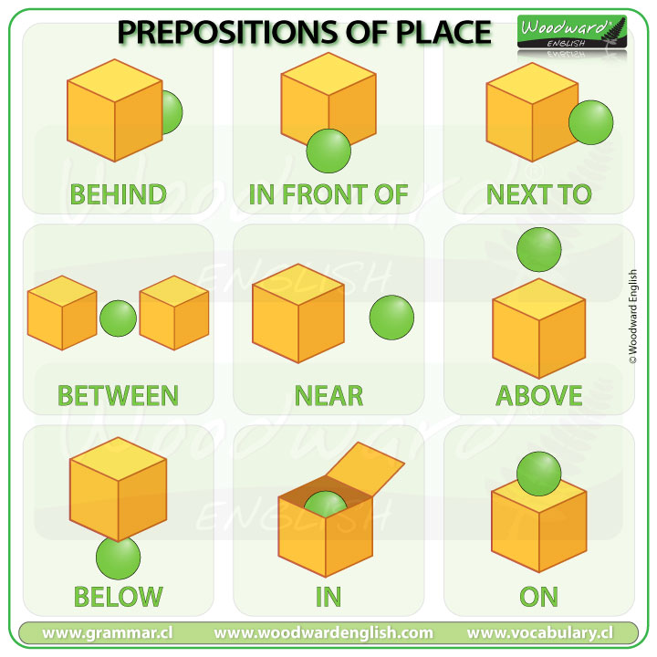

Slide 36
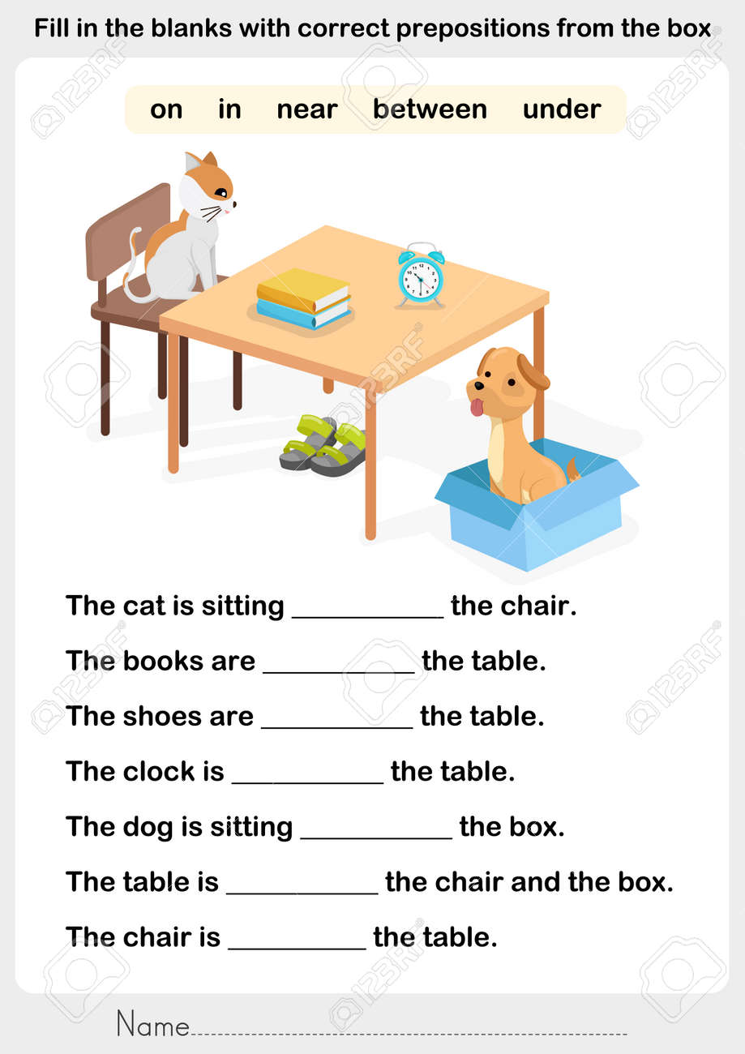

Slide 37
on
on
under
on
in
between
near

